Slide 1
NASCAR
Fan Rewards Survey Concept

Slide 2
NASCAR

Slide 3
Scraped data is a small fraction of the profile
 | Scraped | DataLucent API | DataLucent Download
GDPR/CCPA PRIVACY COMPLIANCE | NOT COMPLIANT | FULLY COMPLIANT | FULLY COMPLIANT
Posts and tweets
Likes and reactions
Event invitations and responses
Organization and group memberships
Uploaded pictures and videos | LIMITED
Viewed pictures and videos | LIMITED
Sports, music, hobbies |  | LIMITED
Marketing categories of interest
Ad serves and responses
Search histories
Network profile information
Mobile/web apps installed
App utilization
✓*
✓
✓
✓*
✓
✓
✓*
✓
✓
✓*
✓
✓
✓
✓
✓
✓
✓
✓
✓
✓
✓
✓
✓
*Publicly available views only

Slide 4
Facebook data is completely comprehensive
Photos, videos, text and status updates you've shared on Facebook
Posts that people tag you in
Posts other people have shared on your timeline
Posts that you've chosen not to show on your timeline, including posts you've created and posts that other people have created
Notes you've created or have been tagged in
Polls you've created or participated in
Comments you've posted
People you are currently connected to
Requests sent to others to ask them to be friends on Facebook
Requests from others asking you to be friends on Facebook
People who you are no longer connected with on Facebook
Messages you've exchanged
Events you've created
Your responses to events including Attending, Maybe, Interested and Not Going
Event invitations you've received
People, organizations, or businesses that you choose to see content or posts from
Your Payment History
Names of the places you've created, their locations, and the time and date you created them
See what Facebook info is available on your Portals
Albums created for your Portal
Photos you've uploaded and shared
Photos and videos you've been tagged in
Videos you've uploaded and shared
Posts and comments you've liked or reacted to
Pages you've liked or reacted to
People who follow you
Groups you belong to
Dates you joined the groups you belong to
Posts and comments you make in the groups you belong to
The date you created your account
Your name, birth date, work and education information and places you've lived that you've added to your profile
Hobbies you've added to your profile
Items you've sold on Marketplace
Posts, photos and videos you have saved
Collections you've created of posts, photos and videos you've saved, and collections you're a part of
Apps you've used Facebook to log into
Apps you're the admin of
Posts from the apps you've given permission to post on your behalf
Pokes you've given and received
Polls and Game Shows you've participated in and Questions you've answered
Your volunteering preferences and activity
Your interests based on your Facebook activity and other actions that help us show you relevant ads
Advertisers who run ads using a contact list they uploaded that includes contact info you shared with them or with one of their data partners
Your activity from the businesses and organizations you visit off of Facebook
Advertisers whose ads you've clicked on Facebook
Words, phrases and names you've searched for
Videos you've searched for
Periods of time you've been actively logged into Facebook
A history of your logins and logouts on Facebook
The computers and mobile phones you've saved to your Facebook account
Life stage description of your friends on Facebook
Your Face Recognition settings allow you to choose if you want Facebook to be able to recognize you in photos and videos.
Contact information you've added for friends and other people
Videos you've watched on Facebook
A history of precise locations received through your devices
Your primary location
Your name, birth date, work and education information and places you've lived that you've added to your profile
Significant actions or events you've added to your profile
Songs you've added to your profile

Slide 5
Understand Fluid Fans in a new era
Consumers will connect themselves to leagues, teams, and products they trust as they re-engage
How can leagues re-engage risk-averse fans?
What are the best ways to make fans feel safe watching live sports?
How will eSports factor into fan re-engagement?
What new interactive technologies will be most relevant to fans as they decide how to re-engage with teams?
Will fans watch games originating from empty stadiums?
What cross-league/cross-team indicators are associated with Fluid Fans?
What cross-platform mix is most relevant and actionable to teams and leagues?
How does gaming influence sports consumption?

Slide 6
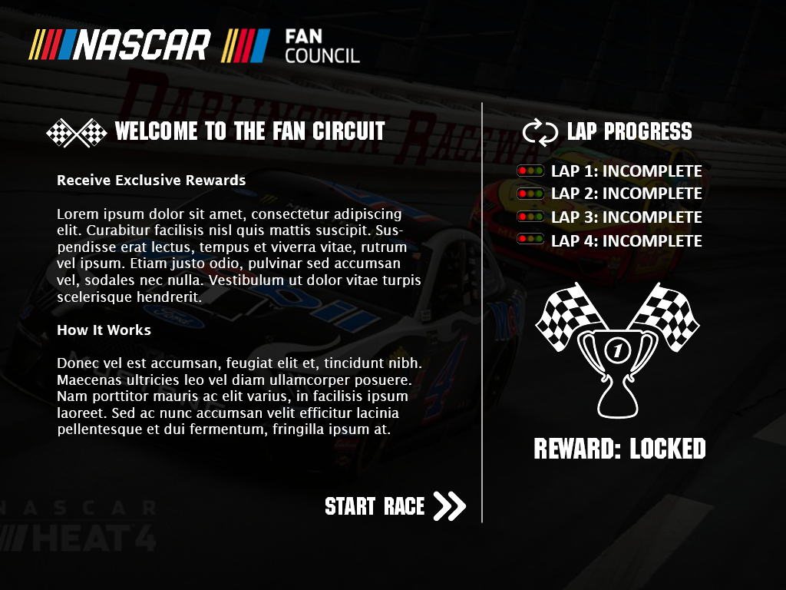
Intro Message
Gamified Experience Walks the Fan Through the Process
Tracks Progress
Reward Status
Starts Process

Slide 7
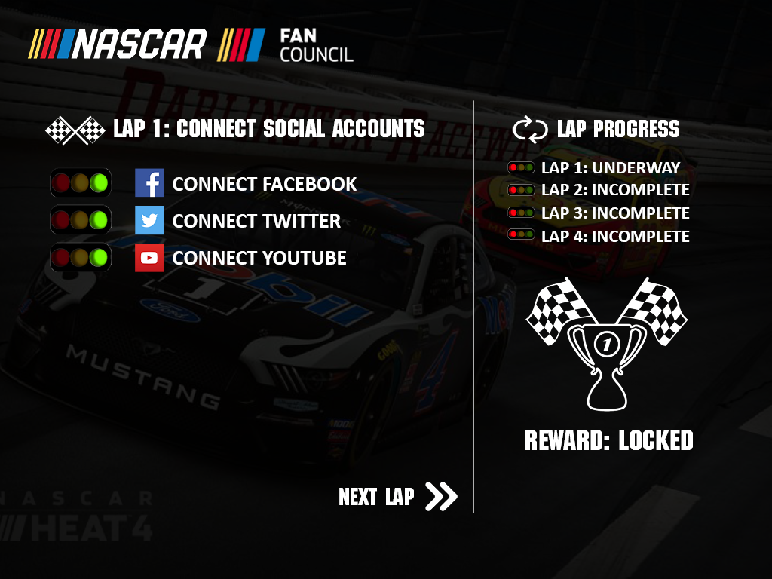
Connecting Social Media Accounts
Stoplight status indicator shows if the fan has connected their account successfully
Logging in sets the fan up for the data download/upload process as well

Slide 8
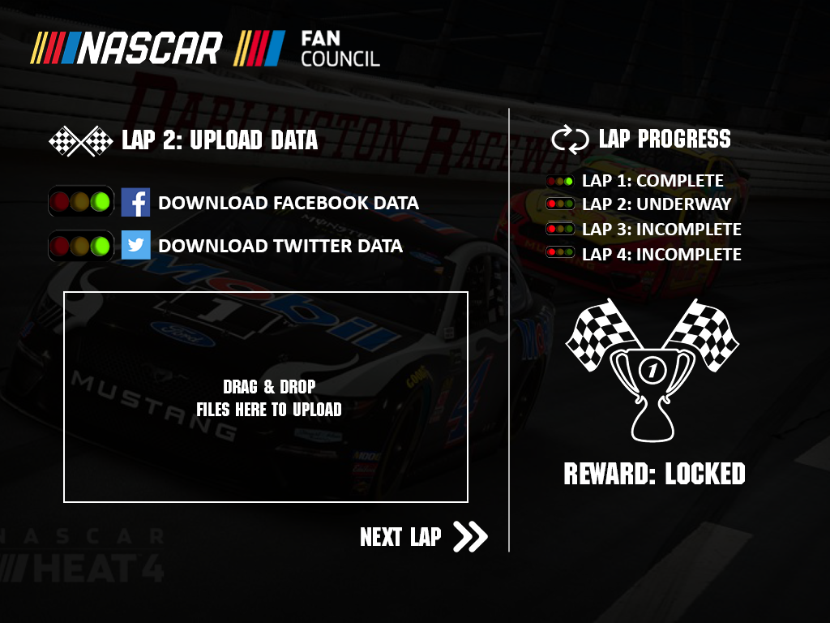
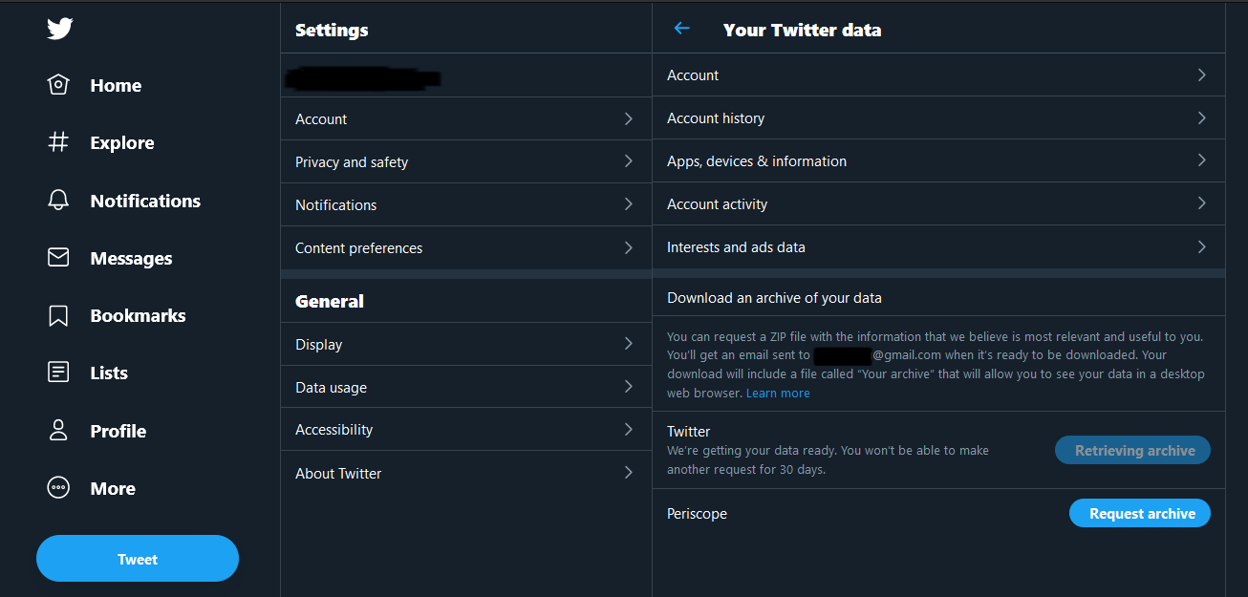
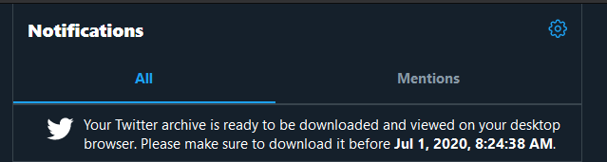
Data Upload/Download
Fans are provided a direct link to the location where they can download their data. The fan has logged into these accounts in the previous step, making this step smoother.
Fans drag their data files into the box and the upload process verifies the file.

Slide 9
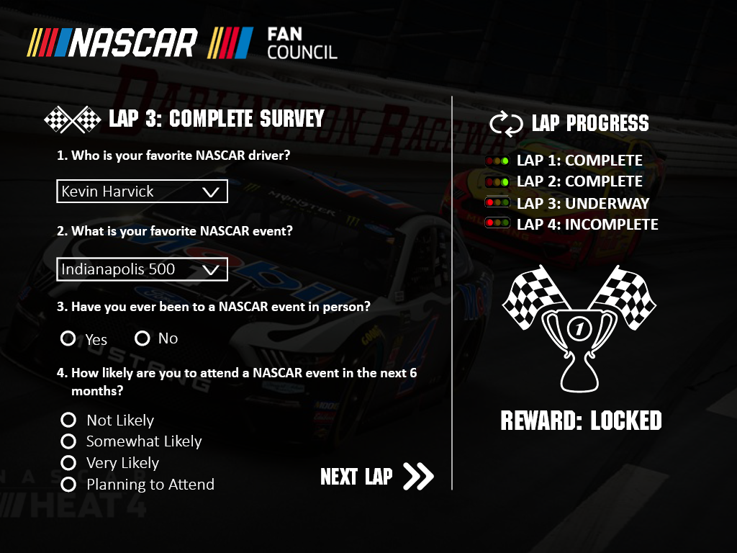
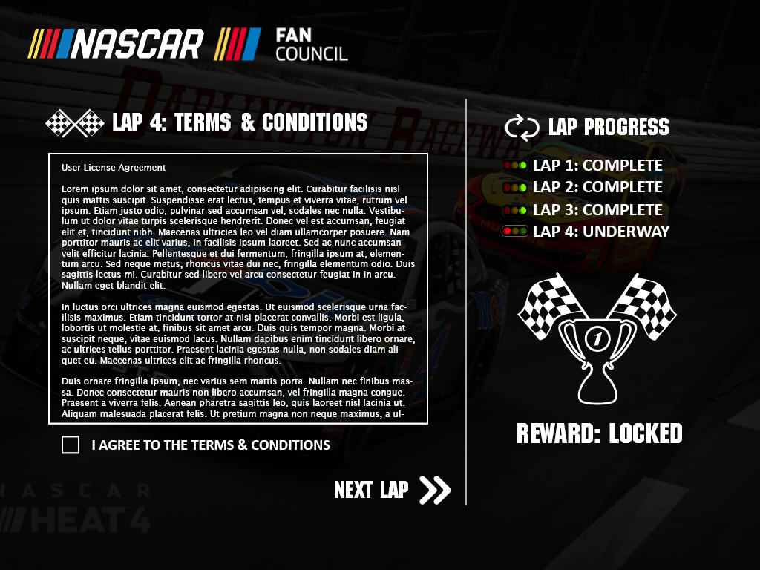
Surveys & License Agreement

Slide 10
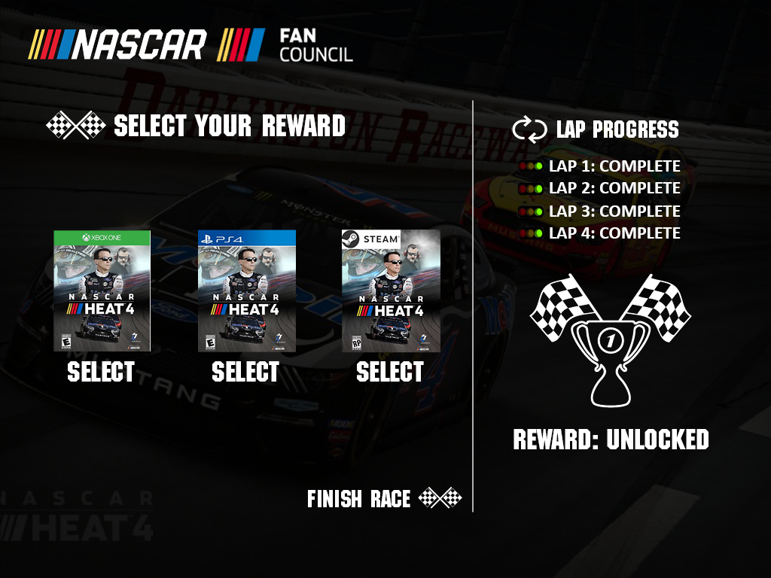
Reward Selection
After the process is finished, the reward is unlocked and the fan receives a reward of their choice.

Slide 11
Thoughts/Questions
Can this work on mobile?
Can iOS/Android download/upload files? – filesizes very large
Filesizes of facebook and twitter will be large if all data is included
Upload times could be <30min per file
A/B Testing?
Create a simpler/not-gamified version
Survey Monkey Limitations
Social data file sizes exceed survey monkey’s max upload filesize
Reward delivery?
Recommendation: for this POC only use twitter as data source or provide directions on how to limit data in the file
Ex Google: Google Pay, YouTube History, Google Shopping, Chrome history

